Slide 1

OVERCOMING MODELING CHALLENGES IN THERMOSET SHAPE MEMORY POLYMERS: A MACHINE LEARNING APPROACH
PRESENTED BY: AMA A. DARKWAH
SUPERVISED BY: DR CHENG YAN

Slide 2
OUTLINE OF PRESENTATION
Introduction
Problem Statement
Relevant Literature
Objective
Work Done
Current Work
Next Step

Slide 3
INTRODUCTION
Shape memory polymer (SMP) is a type of smart material, which can return to the initial shape by responding to external stimuli such as
heat
moisture
magnetism
ph solution etc.

Slide 4
Shape memory polymers are used in areas such as
Aviation
Health
Fashion
Automobile engineering

Slide 5
INTRODUCTION CONT’D
Machine learning is when we teach computers to learn patterns in data such that they can recognize those patterns and apply them to new things.
A neural network is a machine learning algorithm that mimics the human brain to recognize relationships in data
Notes:
Neural networks “learn” to perform tasks by considering examples, generally without being programmed with any task-specific rules.

Slide 6
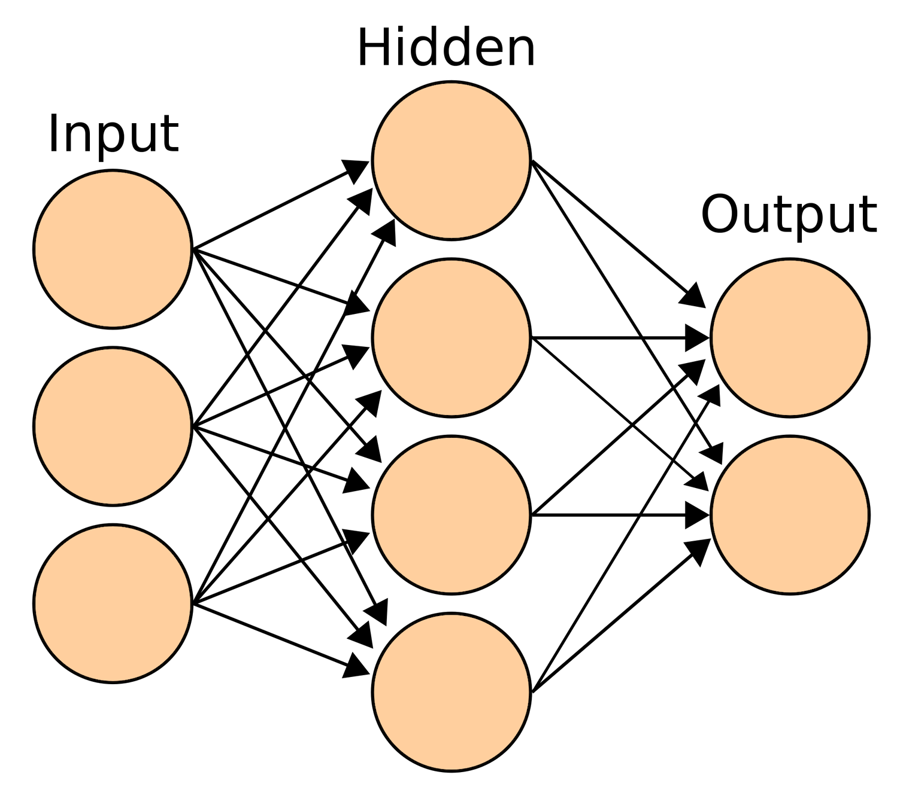
INTRODUCTION CONT’D
Notes:
Input layer — initial data for the neural network.
Hidden layers — intermediate layer between input and output layer and place where all the computation is done.
Output layer — produce the result for given inputs.

Slide 7
PROBLEM STATEMENT
In the synthesis of SMPs;
Experiments are fairly time-consuming
Improving target behavior is limited to the researcher’s cognition

Slide 8
THE SOLUTION
Compared with the experimental models, machine learning has a speed advantage
Given enough data, Machine learning methods can effectively extract useful information, eliminating cognition
ML has the potential to produce a universal model instead of a specific model.
Notes:
Molecular dynamics (MD) is a computer simulation method for analyzing the physical movements of atoms and molecules

Slide 9
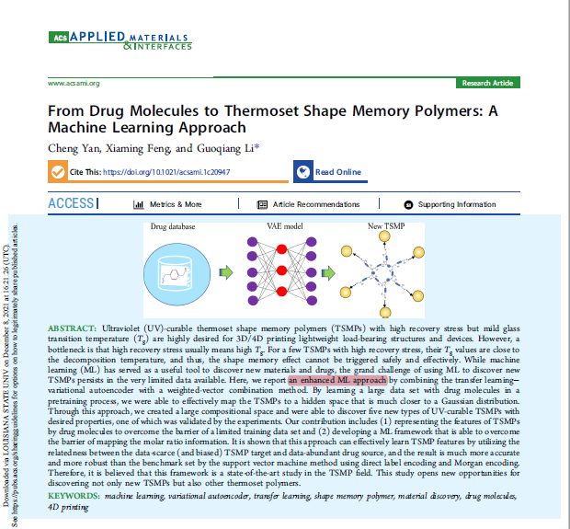
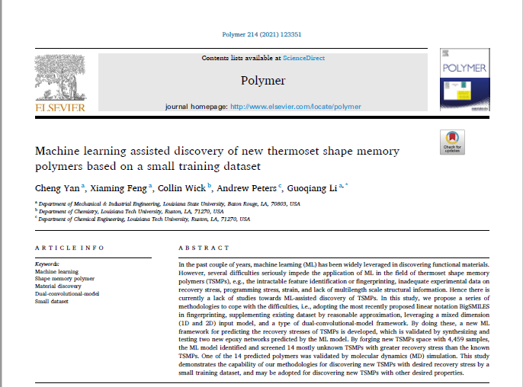
RELEVANT LITERATURE
Yan et al. (2020)
Yan et al. (2021)

Slide 10
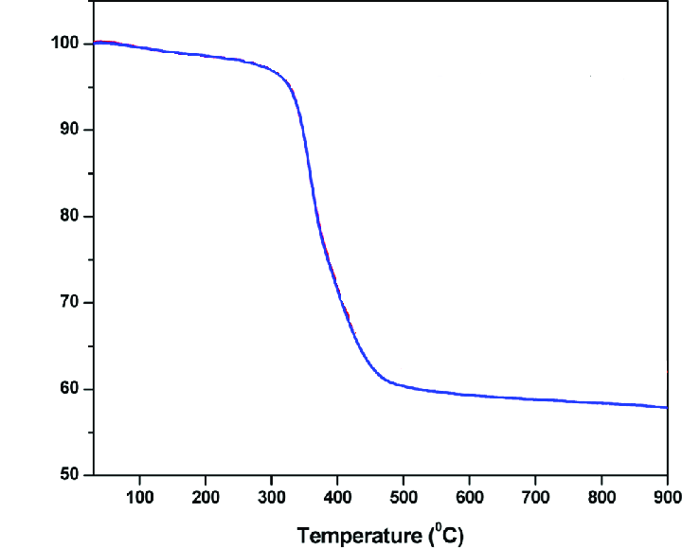
OBJECTIVE
Predict the storage modulus curve of a thermoset shape memory.
Glassy state
Storage modulus (MPa)
Rubbery state
Notes:
Storage modulus is the indication of the ability to store energy elastically.

Slide 11
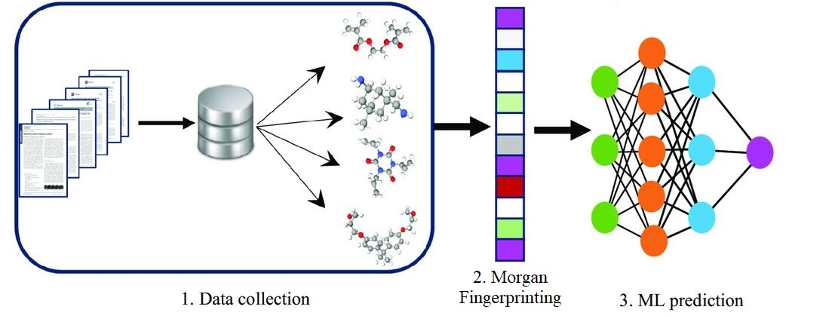
WORK DONE
Collected over 260 data points from literature for four different data sets.
Built models for the glassy modulus of the graph.

Slide 12
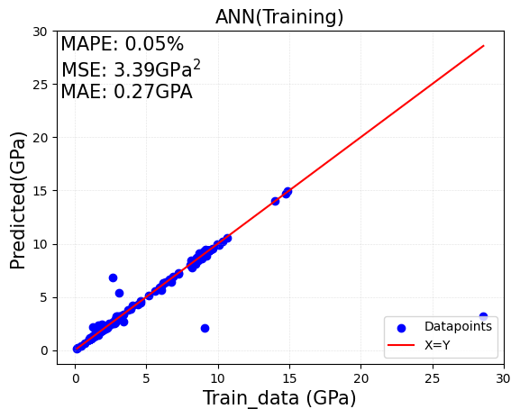
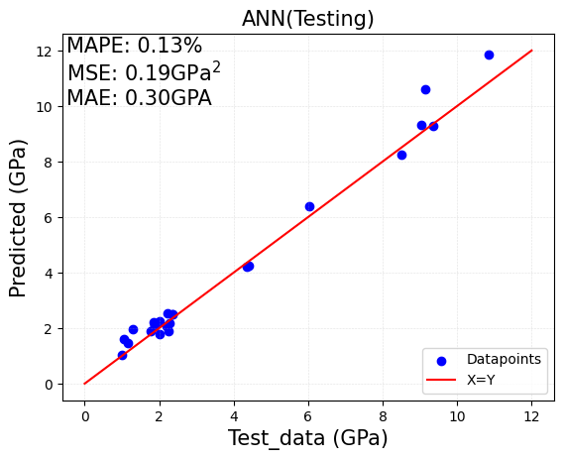
RESULTS FROM THE GLASSY MODULUS MODEL
Models | Mean Absolute Percentage Error (MAPE), % | Mean Squared Error (MSE), GPa² | Mean Absolute Error (MAE), GPa
Artificial Neural Network | 13 | 0.19 | 0.30
Support Vector Regression | 17 | 1.96 | 0.66
Gaussian Process Regression | 18 | 0.48 | 0.50

Slide 13
CURRENT WORK
Building a model for predicting the rubbery modulus
Collection of data
Exploring methods for dealing with overfitting

Slide 14
NEXT STEPS
Build two more models for the high and low temperatures.

Slide 15

THANK YOU

